Slide 1
“The greater danger for most of us lies not in setting our aim too high and falling short but in setting our aim too low and achieving our mark.”
Michelangelo

Slide 2
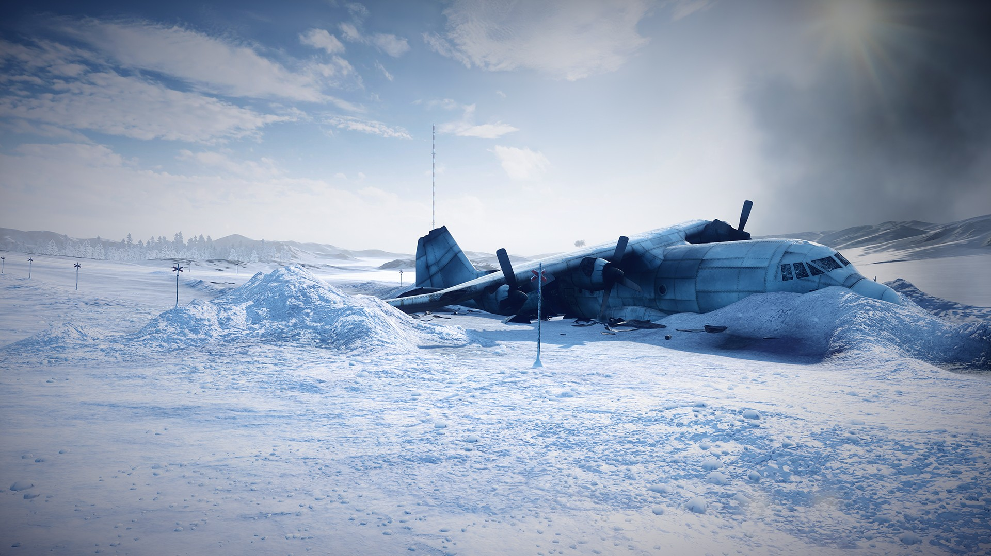
stranded

Slide 3
You and your companions have just survived the crash of a small plane. Both the pilot and co-pilot were killed in the crash. It is mid-January , and you are in Northern Canada. The daily temperature is 25 below zero, and the night time temperature is 40 below zero. There is snow on the ground, and the countryside is wooded with several creeks crisscrossing the area. The nearest town is 20 miles away. You are all dressed in city clothes appropriate for a business meeting. Your group of survivors managed to salvage the following items:
A ball of steel wool
A small ax
A loaded .45-caliber pistol
Can of Crisco shortening
Newspapers (one per person)
Cigarette lighter (without fluid)
Extra shirt and pants for each survivor
20 x 20 ft. piece of heavy-duty canvas
A sectional air map made of plastic
One quart of 100-proof whiskey
A compass
Family-size chocolate bars (one per person)
For the next 8 minutes, place them in order of importance for your survival. ALSO record what you would do with each.
Within your content group.
Determine….
Name your group
If you will leave to seek out help OR stay to wait for help.
As a group, rank your order of importance. Be ready to defend why and its purpose.
You MUST come to group consensus.
10 minutes to complete task.

Slide 4
Reflection
Reflect upon..
What did you notice and wonder during your gallery walk?
What was the most challenging aspect while working as a team?
What would you think our learning target would be for this activity?
What extension can you do with your students?

Slide 5
Learning Target
I can collaborate and work with a team to solve problems.
I will use my background knowledge to complete the assigned task.

Slide 6
Yeah that seem great but……
What are problems when group work begins?
Within your group.
Within your group, determine solutions on how to “solve” each problem. Record thoughts on poster provided. When finished, place your poster up along walls.
Gallery Walk
During your walk, are these things we can agree to as a community when working in groups?
If no, what solutions would you recommend?

Slide 7
Crafting Our Community
Bullitt County Way

Slide 8
Getting Us Started
In your journal, write about the following….
What does your learning community look like in your classroom?
What are you non-negotiables within your learning community?

Slide 9
Learning Target
We will create norms for cohort, that we believe, cultivate communities of thinkers which heighten learning.
We will use our personal experiences and our belief in student success to determine importance.

Slide 10
“Yeah – but..”
“This is just a fad that will pass, like everything else in education – revolving door.”
You don’t know “Jack”
“We have already done this, why are we doing it again?”

Slide 11
What’s your image?
Think about an image that reflects what you want your learning community to look like?
Take 3 minutes to sketch or find your image (you may use your technology, if needed).
Share with your table and discuss why you chose this image.

Slide 12
Memory Lane
Think about a time in your life when you had a positive experience within a learning community. It can be any group where you learned something. Examples include but are not limited to a church group, a club, a team, classroom or course, or a support group.
In your journal write about the experience reflecting on the following questions….
How was the community structured? What processes were used to develop the structure?
What made your experience positive and lasting?

Slide 13
Memory Lane cont.
Get into groups of four (4), everyone must teach a different content area.
Assign the following responsibilities….
Facilitator, Recorder, Time Keeper, & Reporter
Within your group, determine at least five (5) commonalities that existed between the learning communities. Eliminate “same sport/club/church, etc.” Focus on reason and structure.
8-10 minutes and be ready to report to the group.

Slide 14
Results
Sense of belonging – community
Common Goal/Purpose
Diverse group
Applicable beyond “walls”
Upfront communication with expectations and structure
Build relationships
Camaraderie
Fun and engaging
Accountability to group/self/learning
The reporter from each group reports one (1) commonality.

Slide 15
Vision statement
Bullitt County Public Schools: The leader in educational excellence
Mission Statement
The Bullitt County Public Schools learning community will educate all students to high levels of academic performance as measured by state and national standards by creating and maintaining a positive learning environment with a comprehensive system of support.
We Believe
All children can learn.
Higher expectations will yield higher results.
Excellence is attainable.
All people need a safe environment, both physically and emotionally.
Family and community support is essential.
All people are responsible for their own choices.
Relationships are the foundation of a positive culture.
Learning Community Norms:
Sense of belonging – community
Common Goal/Purpose
Diverse group
Applicable beyond “walls”
Upfront communication with expectations and structure
Build relationships
Camaraderie
Fun and engaging
Accountability to group/self/learning

Slide 16
Give One…Get One
Learning Community Norms:
Sense of belonging – community
Common Goal/Purpose
Diverse group
Applicable beyond “walls”
Upfront communication with expectations and structure
Build relationships
Camaraderie
Fun and engaging
Accountability to group/self/learning
In your journal, think of your community building activities you do at the beginning of the school year. Record five (5) activities and reflect on the questions below:
How do your activities align with our Learning Community Norms?
If they don’t seem to align, what is their purpose?
Walk around and share one activity with another person; talk to at least 5 different people.
Record the new ideas you learned from your colleagues.

Slide 17
Reflection
Before you leave, reflect about the following….
What were your “ah-ha’s”?
What will you implement to develop the learning community within your classroom, that enhances learning?
What lingering questions do you have or what support do you think you might need?

Slide 18
Workshop approach

Slide 19
Your Turn…..
Draw a picture of representing workshop in your classroom. Reflect on the following questions to get your image(s).
How do you vision workshop working in your classroom?
What picture or images demonstrate your ideas, problems, concerns, or solutions?
Get into groups of 5. Each share. Pick one to share with whole group.
5-7 minutes

Slide 20
Learning Target
Thinking Strategies
Workshop
Discourse

Slide 21
Sharing & Reflection
What can my students share that they will grow and/or solidify the thinking of the group?
How will they reflect on new content understanding? On the processes/thinking?
Opening
How do I start the class to allow the following:
Welcoming learning?
Students activating background knowledge related to today’s work?
Learners setting purpose for the lesson?
Managing homework?
Worktime
What rich task will my students engage in?
What thinking strategy will students use to engage with the task?
How will students “hold” their thinking?
Mini Lesson
What do I need to model and think aloud about in order to set my students up for success during work time?

Slide 22
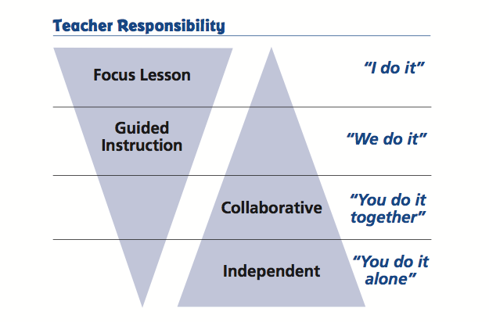
Gradual Release of Responsibility

Slide 23
FINAL REFLECTION
I used to think ______________, but now I know________________.

